Slide 1
Introduction à Tensorflow / Keras.

Slide 2
What is Tensorflow
Open Source software library by Google
Originally created for tasks with heavy numerical computation
Main application : Machine Learning and Deep Neural Networks
C/C++ backend (faster than python)
Based on data flow graphs
Both High and Low Level API

Slide 3
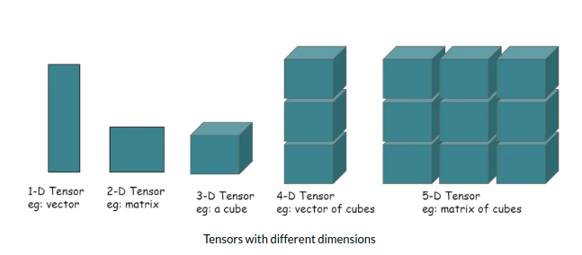
Data representation with Tensors
Scalars : 1D
Vectors : 2D
Time-Series, Sequences : 3D
Images : 4D
Videos : 5D

Slide 4
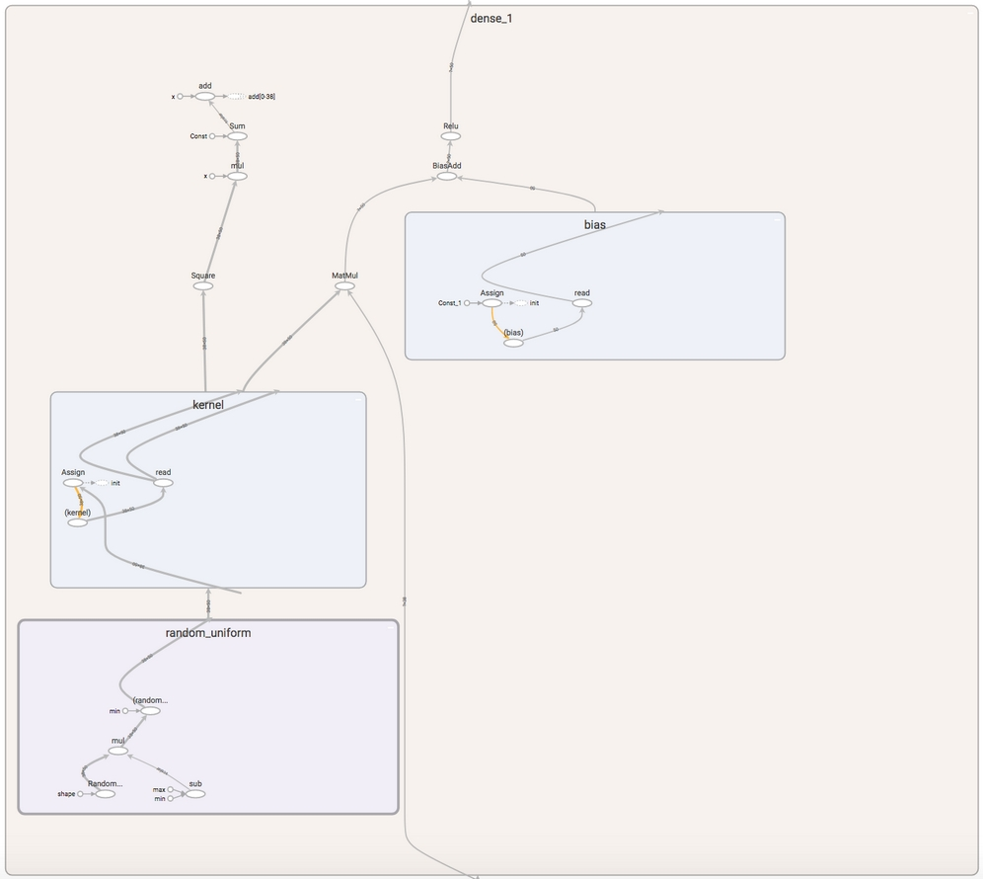
Tensors and the computational graph
Parallel & distributed computations
Specialized hardware (GPUs, TPUs..)
Matrix multiplication & calculating derivatives are easy
matrix multiplication (matmul), adding bias and a ReLU activation function
Notes:
The advantage of structuring computations as a graph is that it's easier to run nodes in parallel. Through parallel computation, we do not need one very fast machine; we can also achieve fast computation with many slow computers (GPUs) that split up the tasks.

Slide 5
What is Keras
Also an open-source software library
Is an interface for Tensorflow
Provides Python with a library for Artificial Neural Network
Exclusively uses High level API
Originally supported differents DL frameworks : TensorFlow, Theano, PlaidML, MXNet, CNTK (Microsoft Cognitive Toolkit )
Easy to Learn and fast Prototyping

Slide 6
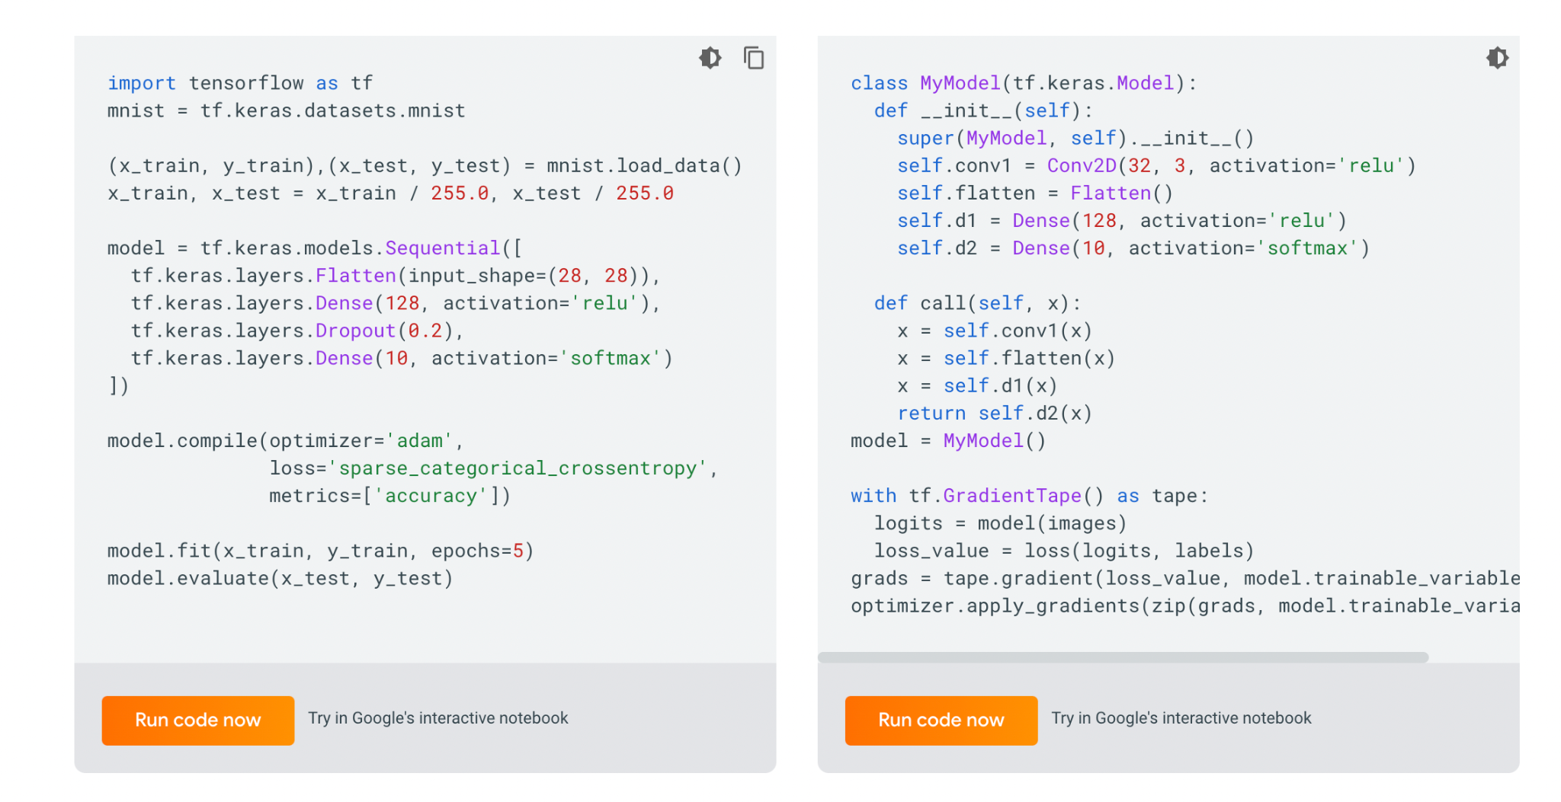
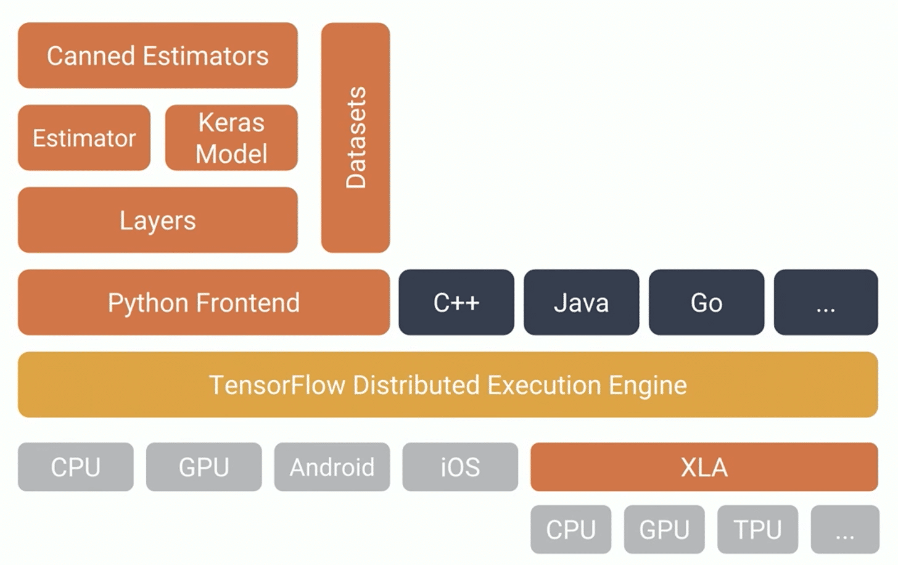
Keras now
over a million users as of late 2021
the Python of deep learning
a single-backend API—on top of TensorFlow
Notes:
By late 2017, a majority of TensorFlow users were using it through Keras or in combination with Keras. In 2018, the TensorFlow leadership picked Keras as TensorFlow’s official high-level API. As a result, the Keras API is front and center in TensorFlow 2.0, released in September 2019—an extensive redesign of TensorFlow and Keras that takes into account over four years of user feedback and technical progress.

Slide 7
Conclusion
Let's get started !

